Slide 1
SawyerAir
Tests by Andronie Bertha

Slide 2
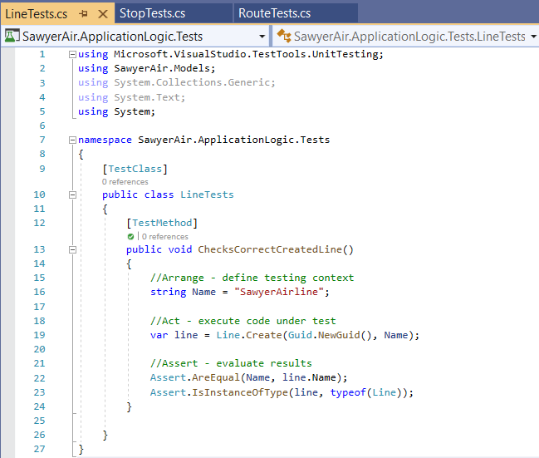
UNIT TESTS: LineTests, StopTests, RouteTests.
LineTests is an unit test which verifies the method Create for Lines.

Slide 3
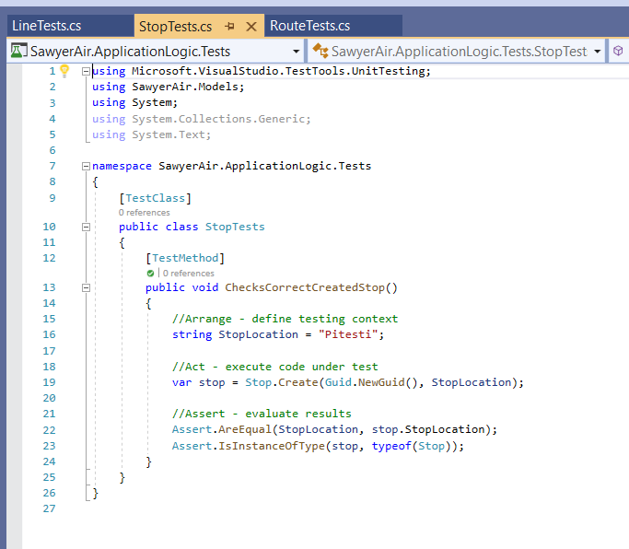
UNIT TESTS: LineTests, StopTests, RouteTests.
StopTests is an unit test which verifies the method Create for Stops. or Stops.

Slide 4
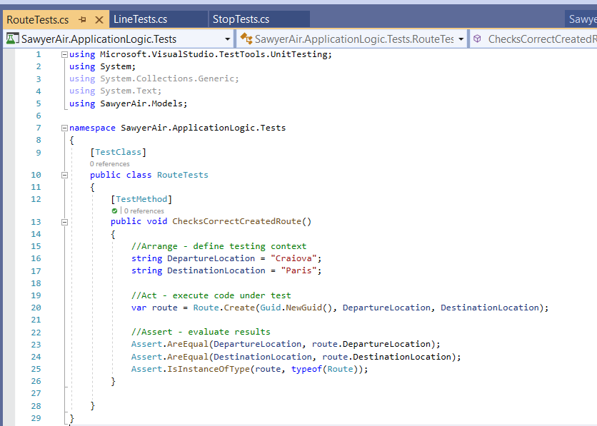
UNIT TESTS: LineTests, StopTests, RouteTests.
RouteTests is an unit test which verifies the method Create for Routes.

Slide 5
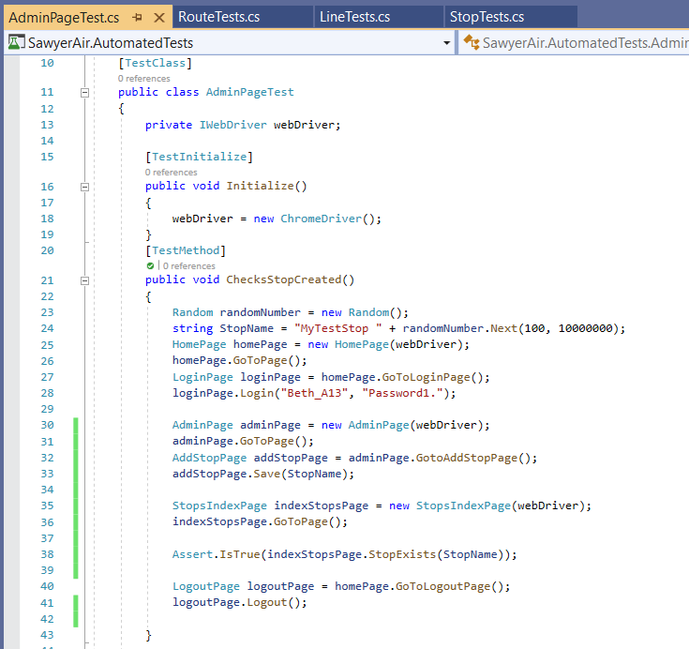
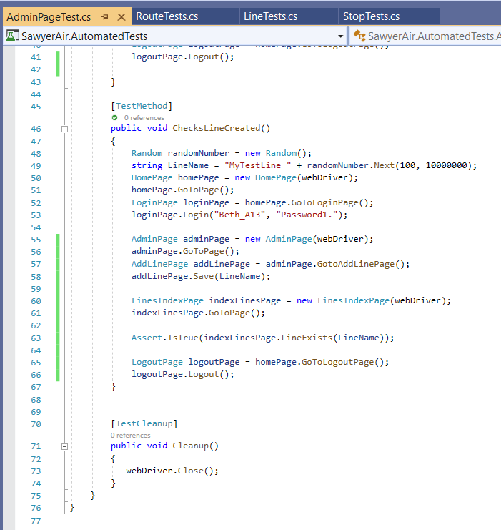
Automated Tests
The Automated Test is called AdminPageTests and it has two methods : ChecksStopCreated, ChecksLineCreated.

Slide 6
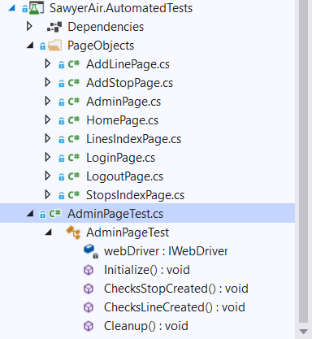
The automated test uses Page Objects and it has been implemented using Selenium.

Slide 7
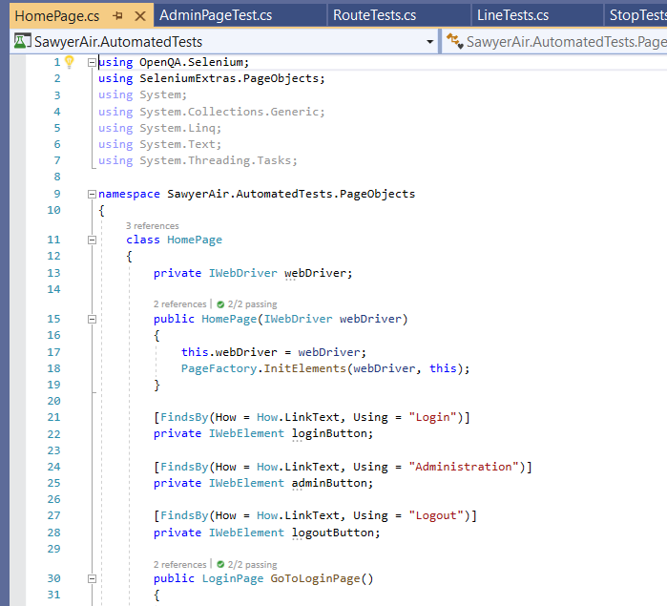
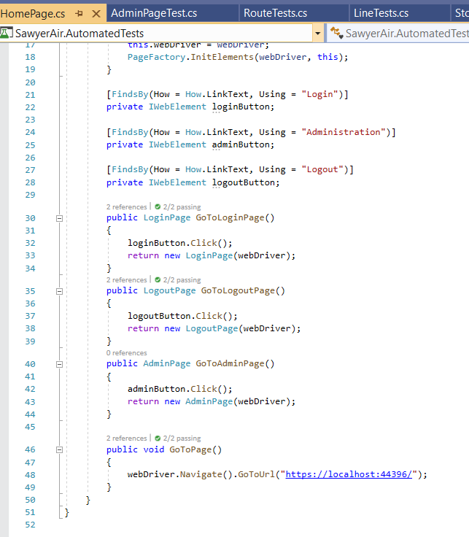
PageObjects: HomePage

Slide 8
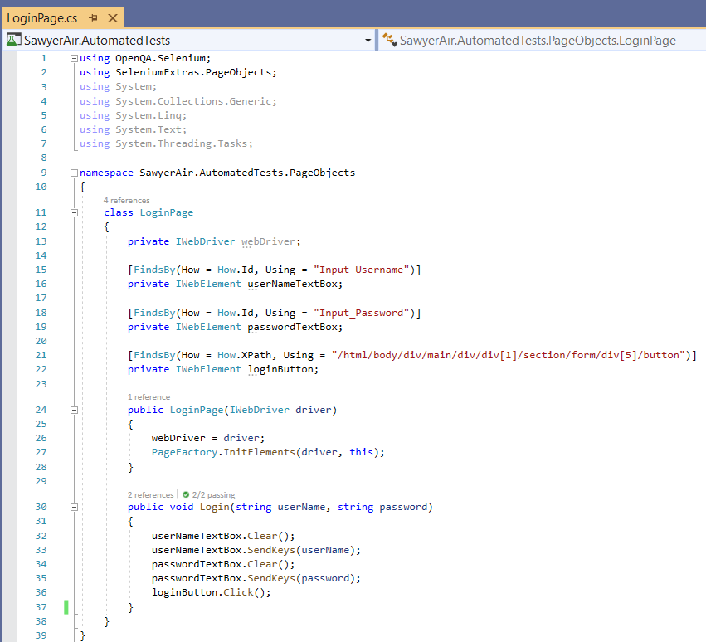
PageObjects: LoginPage

Slide 9
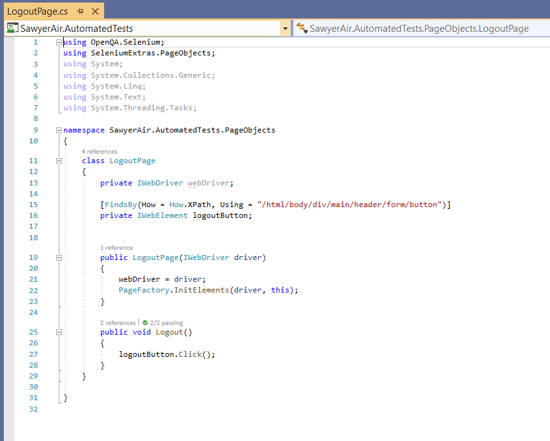
PageObjects: LogoutPage

Slide 10
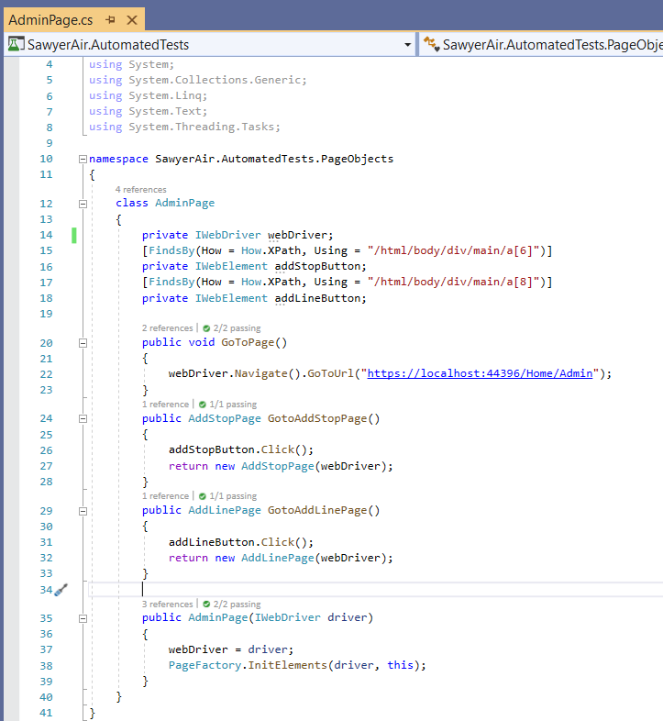
PageObjects: AdminPage

Slide 11
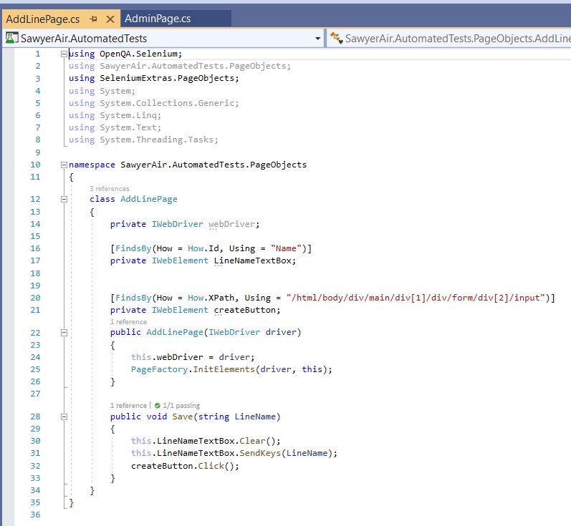
PageObjects: AddLinePage

Slide 12
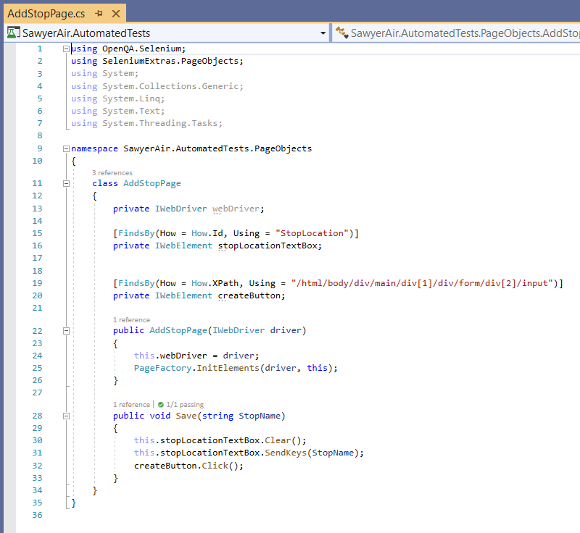
PageObjects: AddStopPage

Slide 13
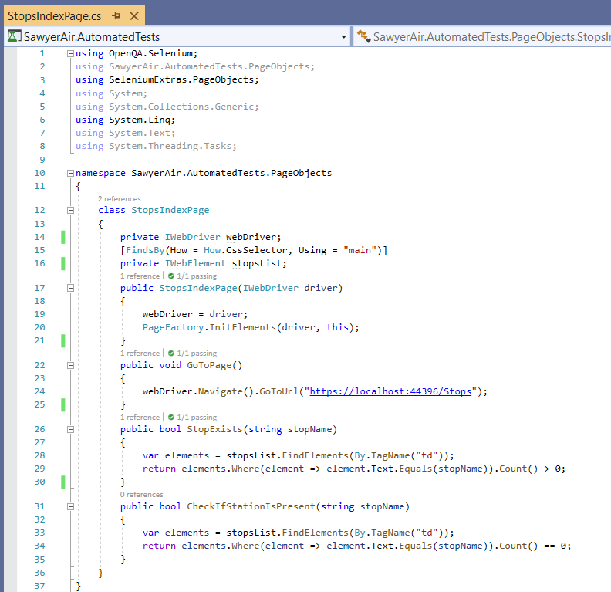
PageObjects: StopsIndexPage

Slide 14
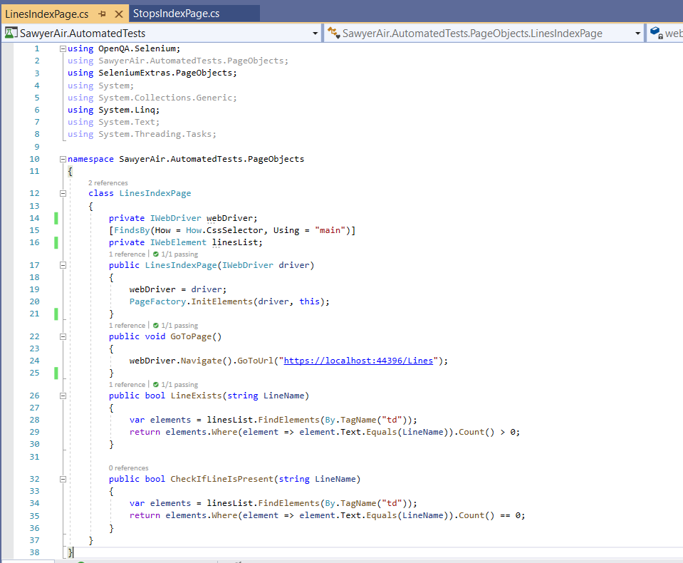
PageObjects: LinesIndexPage

Slide 15
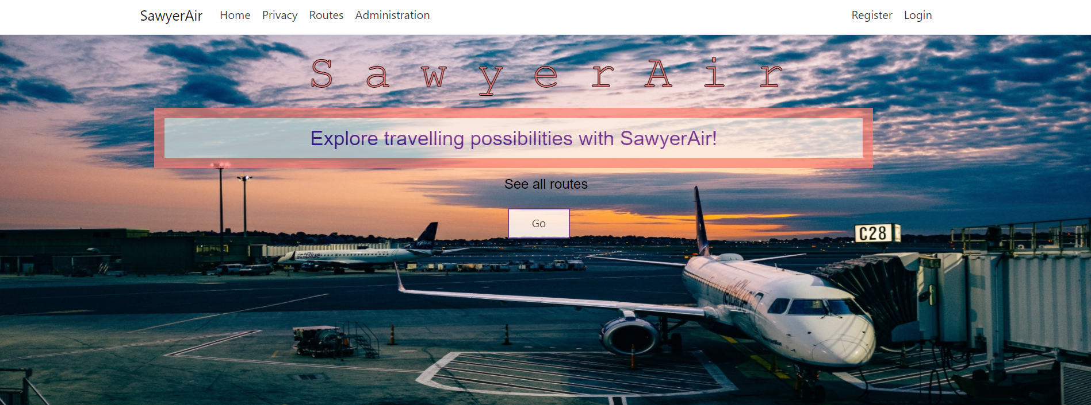
How does the automated test work ?
Method1 : ChecksLineCreated
Firstly, the home page of the application is opened.
Secondly, the login button is clicked.

Slide 16

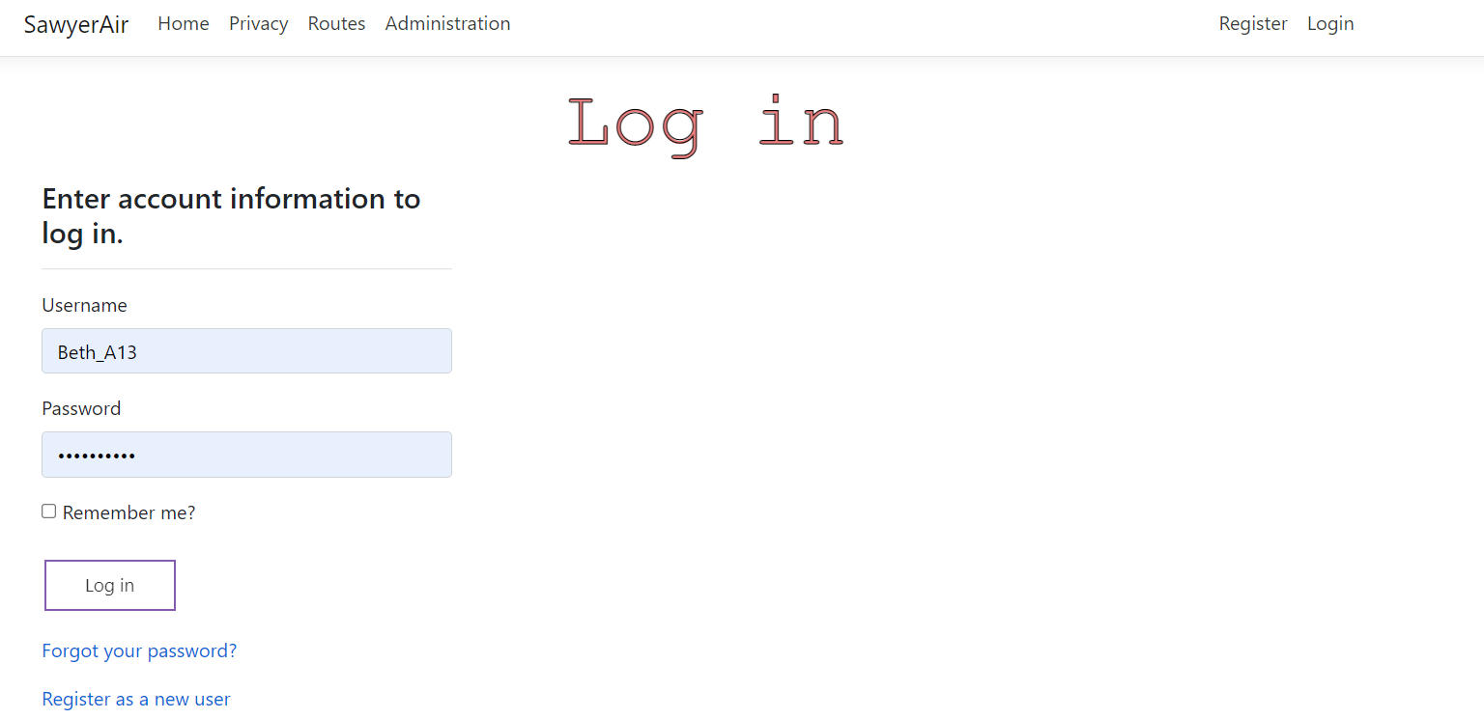
The user is then directed to the LoginPage where username and password are introduced in the presented text boxes.
By clicking on the “ Log in “ button, the user is then redirected to the Administration Page.

Slide 17
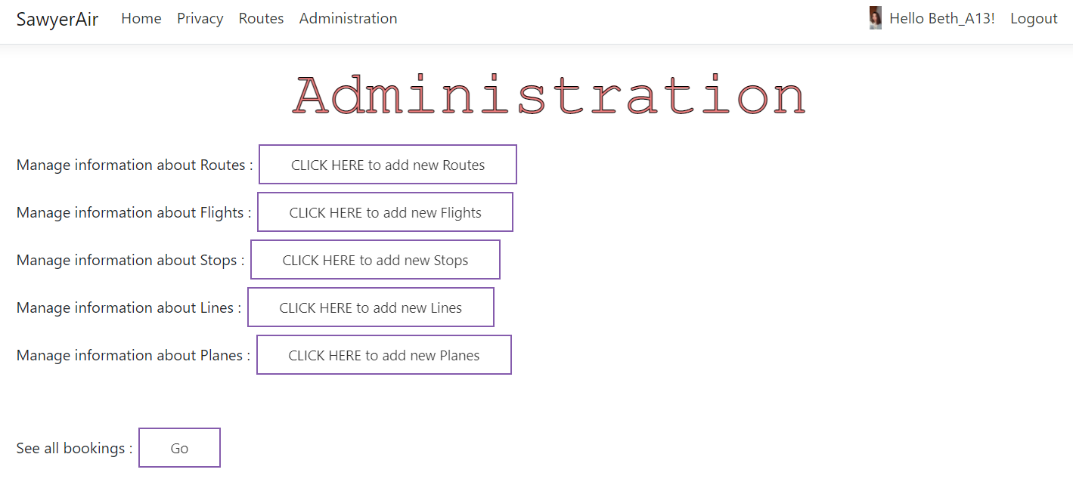
By clicking on the “CLICK HERE to add new Lines”, the user is redirected to AddLinePage.

Slide 18
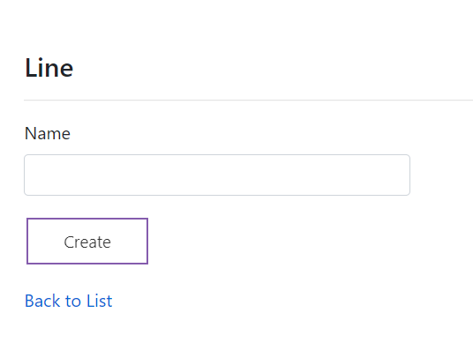
The user has now the option to introduce a new line by filling the input text box
After clicking the Create button, the user is then redirected to the LinesIndexPage.

Slide 19
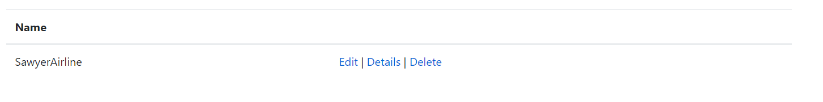
LinesIndexPage :
The automated test AdminPageTests then verifies if the newly added line exists.
After that, the logout button is clicked and it redirects the user to the LogoutPage.

Slide 20
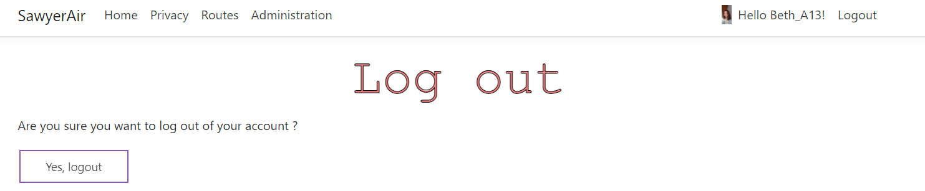
After the Yes, logout button is clicked, the user is then logged out and the automated tests stops.

Slide 21
How does the automated test work ?
Method2 : ChecksStopCreated
Firstly, the home page of the application is opened.
Secondly, the login button is clicked.

Slide 22
The user is then directed to the LoginPage where username and password are introduced in the presented text boxes.
By clicking on the “ Log in “ button, the user is then redirected to the Administration Page.

Slide 23
By clicking on the “CLICK HERE to add new Stops”, the user is redirected to AddStopPage.

Slide 24
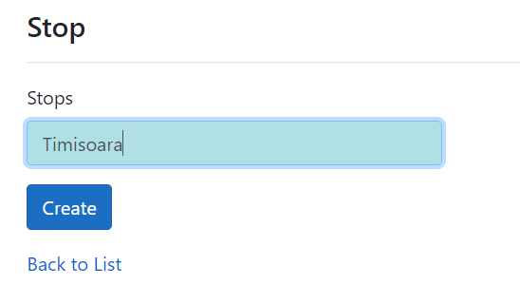
The user has now the option to introduce a new stop by filling the input text box
After clicking the Create button, the user is then redirected to the StopsIndexPage.

Slide 25
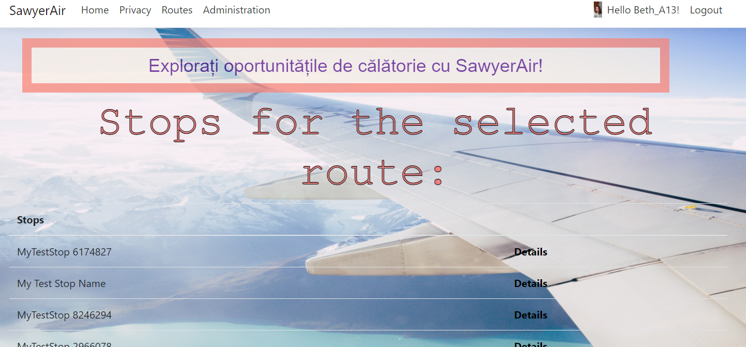
StopsIndexPage :
The automated test AdminPageTests then verifies if the newly added stop exists.
After that, the logout button is clicked and it redirects the user to the LogoutPage.

Slide 26
After the “Yes, logout” button is clicked, the user is then logged out and the automated tests stops.

Slide 27
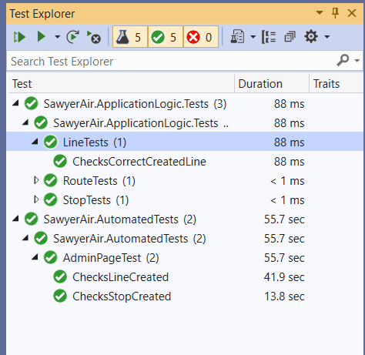
After we run all the tests, the output is the following:

